Slide 1






The Village of South Holland
Lead Service Line Replacement (LSLR) Program
Year 1 – Informational Meeting
Monday, April 22nd, 2024
Notes:
I am Jonathan Flowers, I work for Robinson Engineering. I have been working in the civil/engineering field for about 12 years now. I used to do wastewater pretreatment for municipalities, but now I focus on water and wastewater design projects, mostly water mains and lift stations.

Slide 2

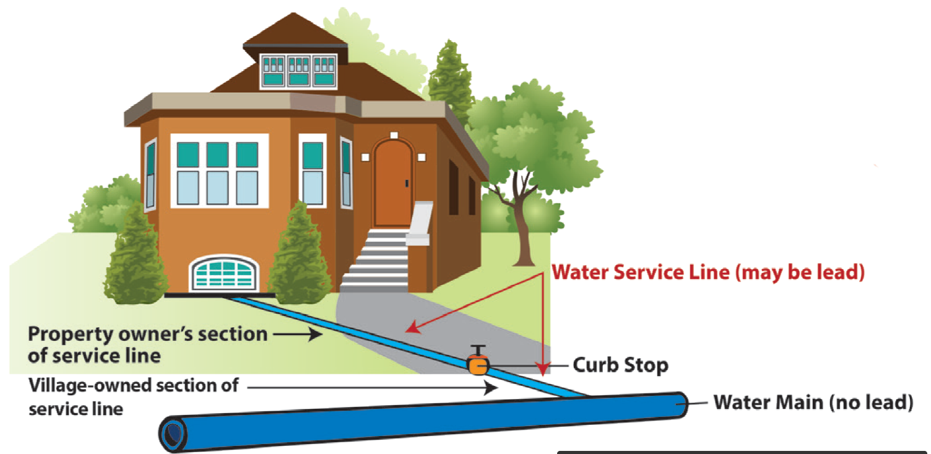
Background: Lead Research and Replacement Process
Water Service Line to be Replaced
Notes:
Increase in the amount of research, better science, better detection levels. The more we find out about lead and its effects, the lower the recommended concentration gets. Steepest part of the dose-response curve is less than 10. The level is planned to decrease further.

Slide 3

Key Program Information: Funding and Replacements
South Holland Lead Service Line Replacement.
  $2,530,000 Construction.
Number of Full Lead Services in South Holland ~ 250.
Number of Partial Lead Services in South Holland ~ 250.
Construction Cost per Full Lead Service Replacement $10,000.
Notes:
George Slide. George, please stress that this decision was prompted by the immediate need for water main replacement.

Slide 4
LSLR Program Timeline: May 2024 – May 2025
Inspections and Access Agreements May 2024.
Potholing June 2024.
Replacements Start July 2024.
Construction Complete May 2025.
Notes:
TOM
Discuss supply chain issues
Computer chips in the meters could add 6 – 9 months, after contracts and shop drawing approvals
One year jobs could now take 1.5 – 2 years if meters are included

Slide 5
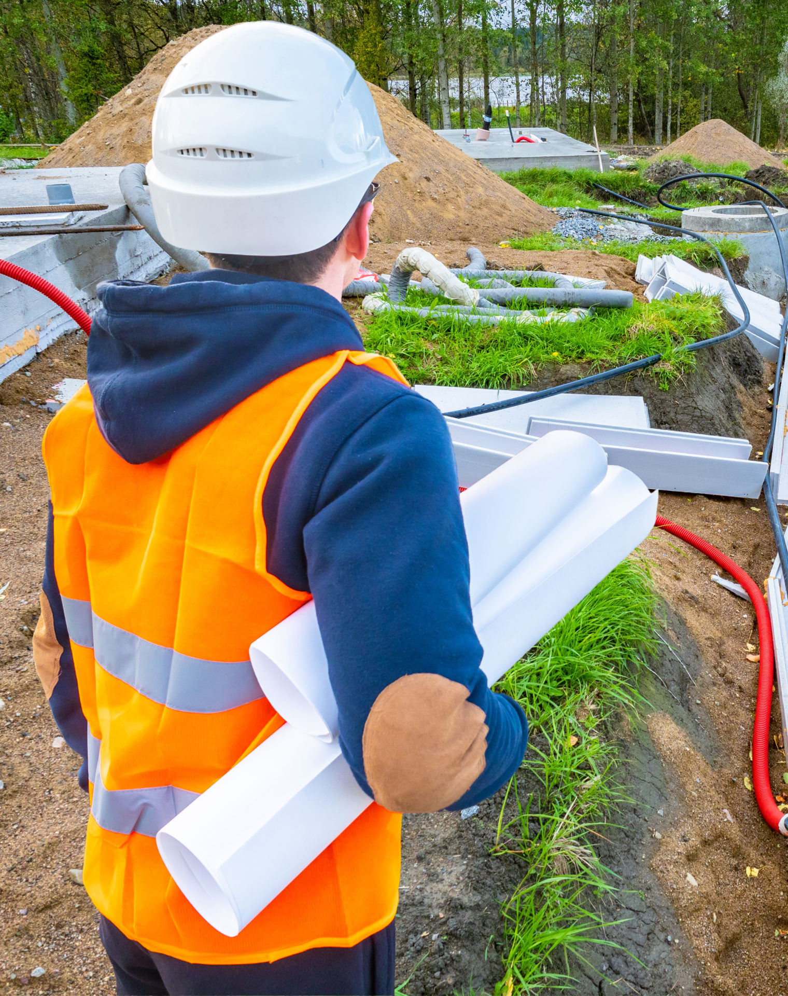
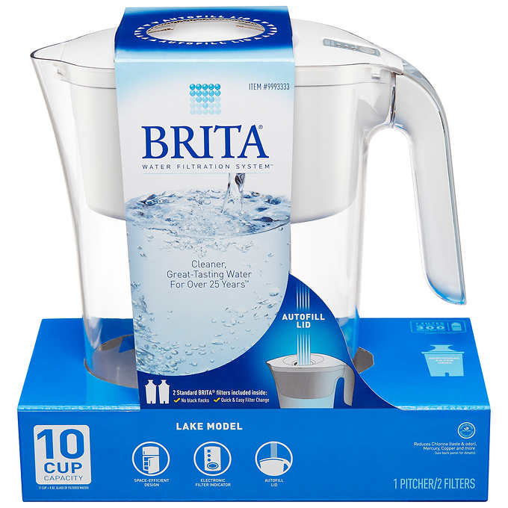
Service Line Construction: Typical Timeline
Mailer Sent to Resident.
  Inform residents of LSLR Program and the contractor, Airy’s, Inc. → See Property Access Agreements.
Contractor Site Meetings.
  Contractor initial site meeting to verify LSL, obtain resident agreement form, and set construction schedule.
Construction of LSL can be installed in ~ 4 hours.
  Resident should expect +/- 8 hours (full day).
Restoration to follow.
Notes:
Jon

Slide 6
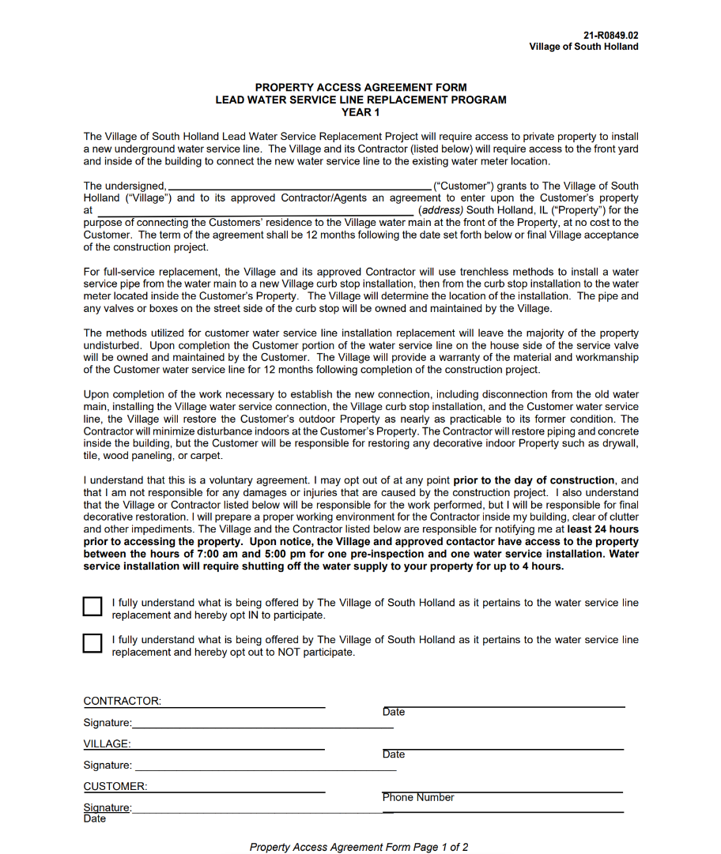
LSLR Program: Requests to Residents
Sign and submit the Property Access Agreement Form mailed to you and available today.
Or complete the Form online at: https://www.gettheleadoutil.com/southholland.
Notes:
TOM
Discuss supply chain issues
Computer chips in the meters could add 6 – 9 months, after contracts and shop drawing approvals
One year jobs could now take 1.5 – 2 years if meters are included

Slide 7
LSLR Process
Notes:
Jon

Slide 8
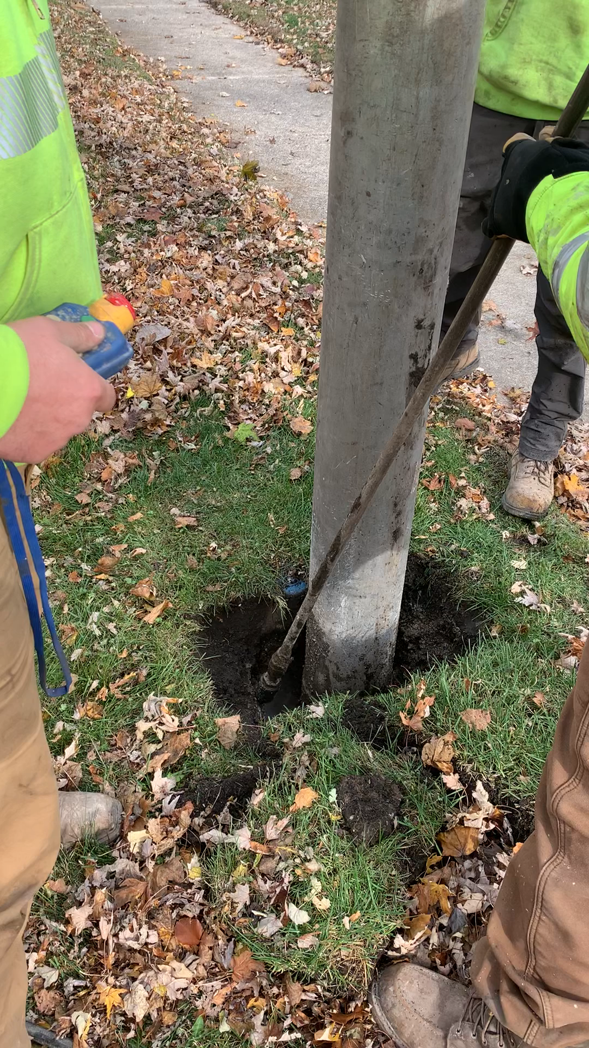
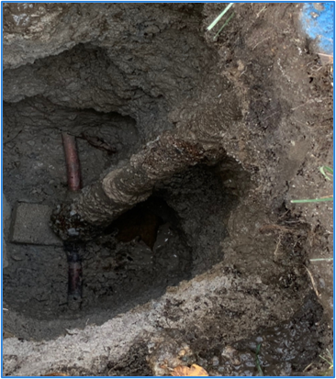
LSLR Process
Notes:
Jon

Slide 9
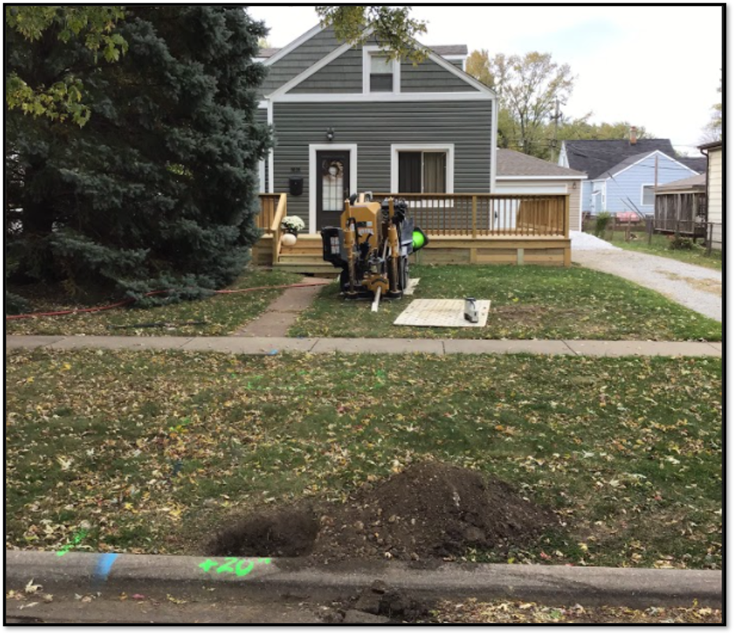
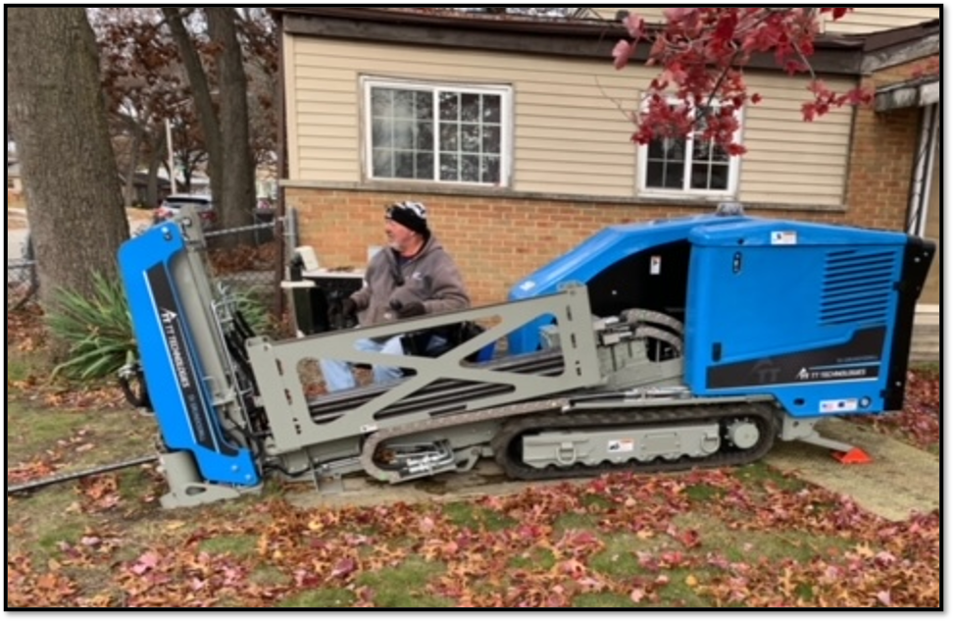
LSLR Process
Notes:
Jon

Slide 10
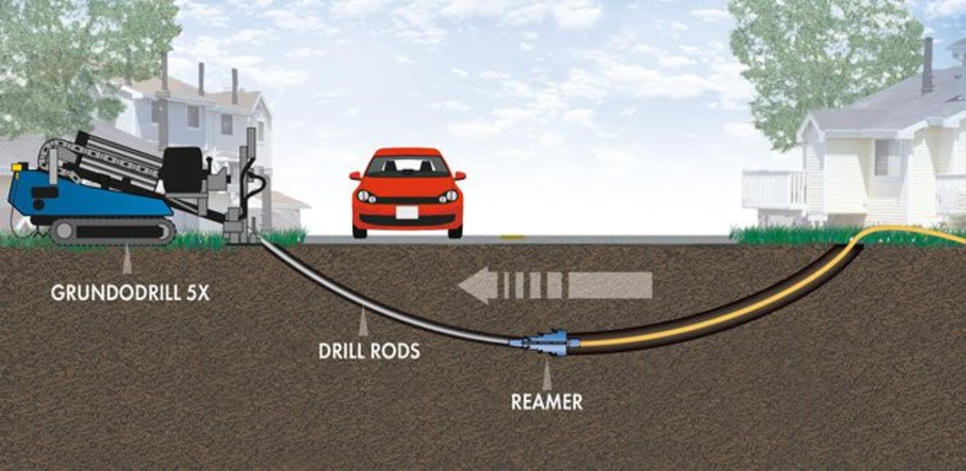
LSLR Process
Notes:
Jon

Slide 11
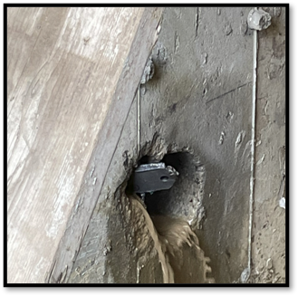
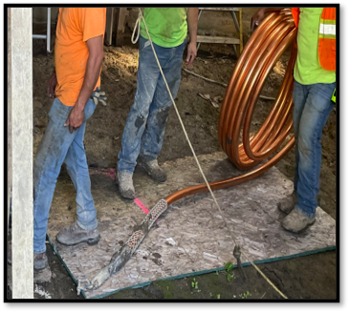
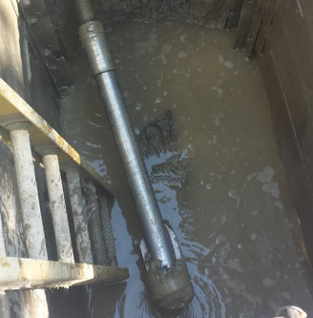
LSLR Process
Notes:
Jon

Slide 12
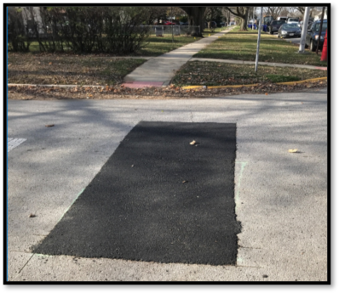
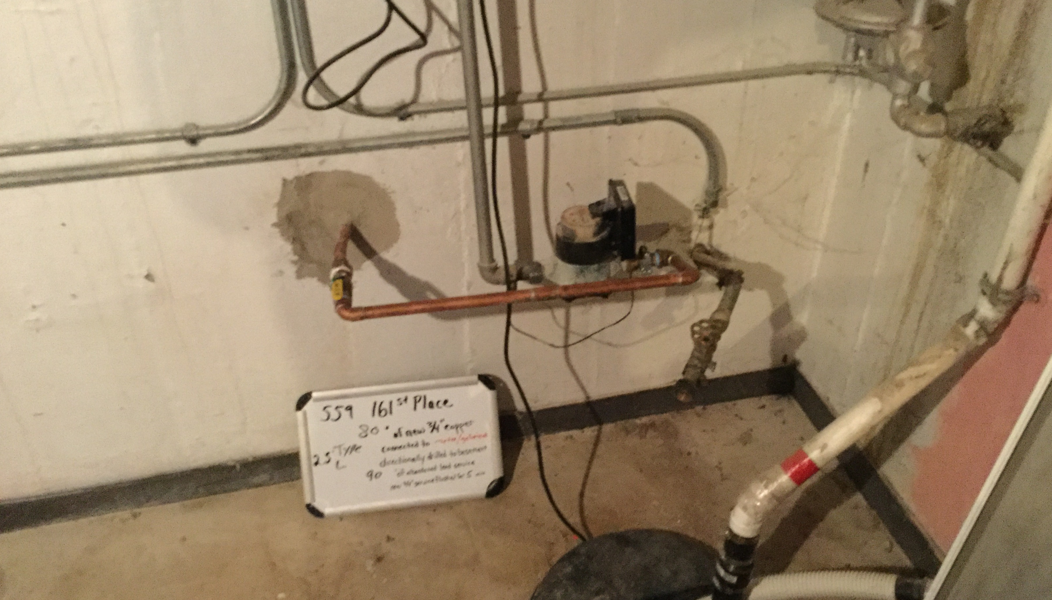
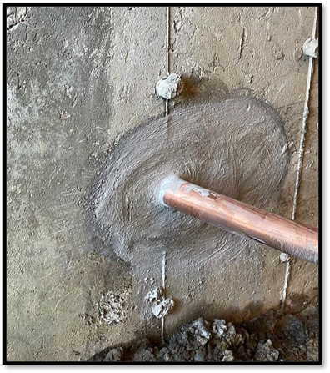
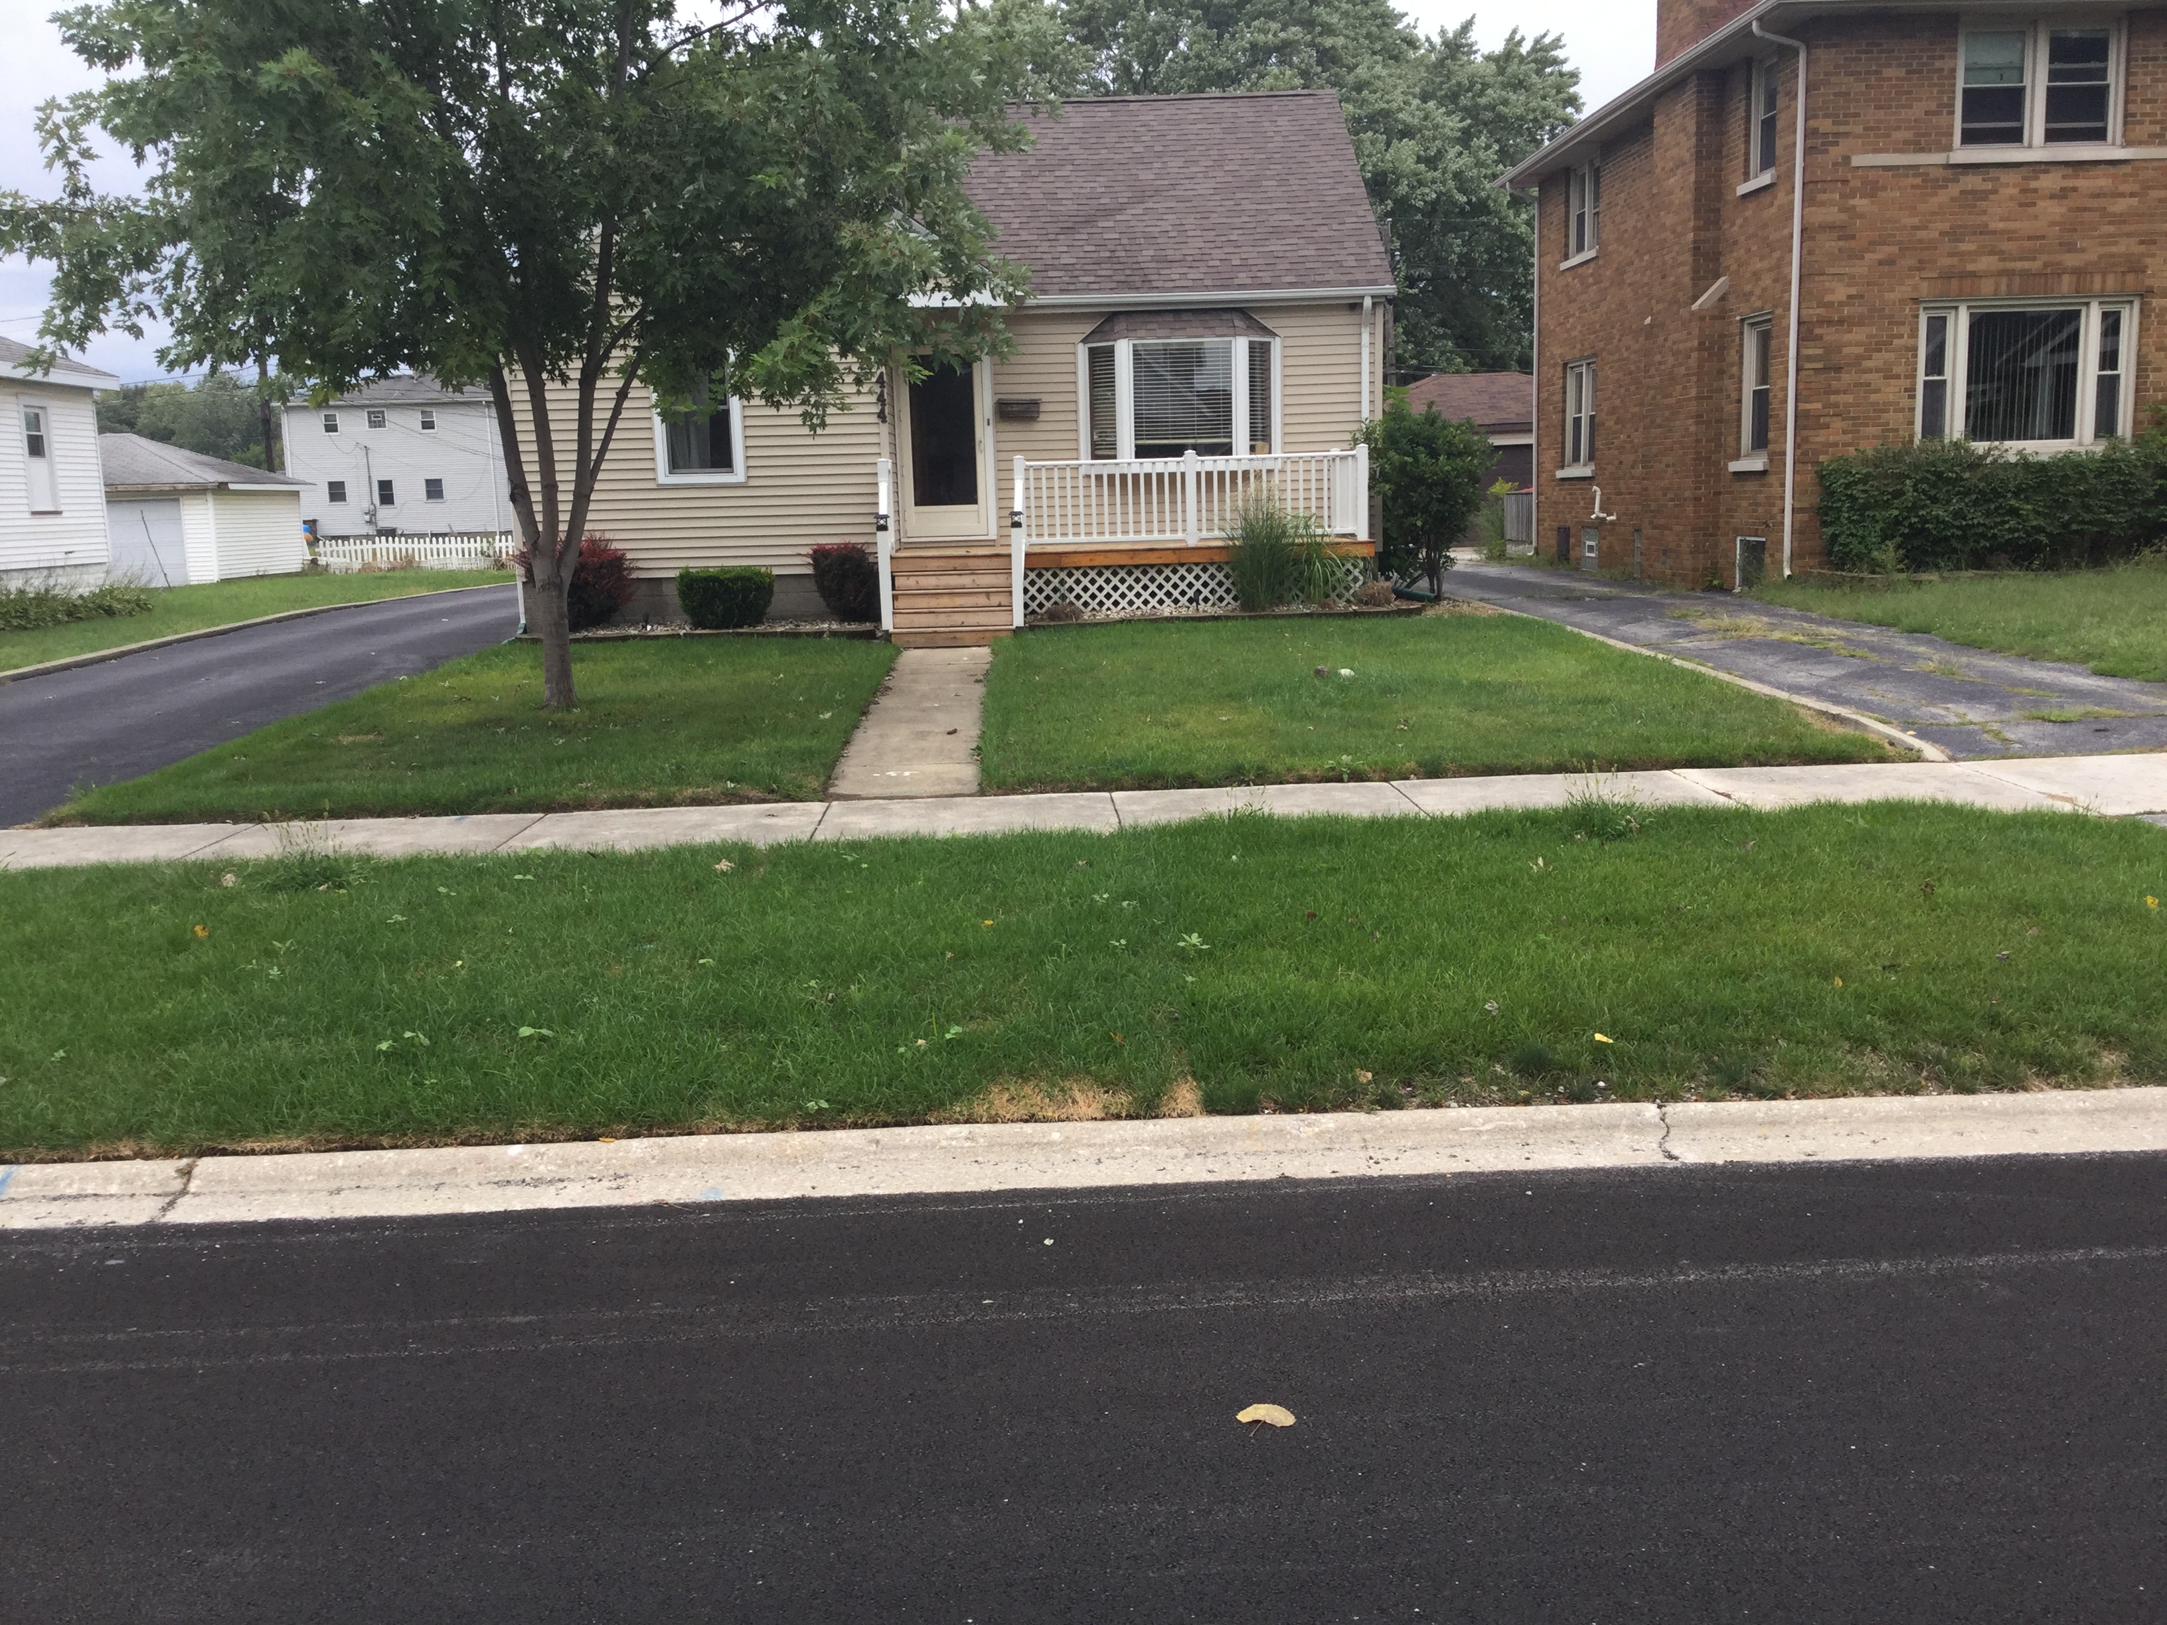
LSLR Process
Notes:
Jon

Slide 13
How will I know that the contractor is the Village’s contractor?
The Village has contracted with Airy’s, Inc. to complete the lead service line replacements for the Year 1 of the LSLR Program.
The Village has also contracted with Robinson Engineering, Ltd to oversee the construction phase.

Slide 14

Thank You!
What Questions Do You Have?

